Slide 1


CLOUD COMPUTING & SECURITY (BIS613D)
MODULE 2
Virtual Machines and Virtualization of Clusters and Data Centers
Dr. Srividya R
Assoc. Professor, ISE Dept.

Slide 2
CCS Module-2
Virtual Machines and Virtualization of Clusters and Data Centers:
Implementation Levels of Virtualization,
Virtualization Structure/Tools and Mechanisms,
Virtualization of CPU/Memory and I/O devices,
Virtual Clusters and Resource Management,
Virtualization for Data Center Automation.

Slide 3

Implementation Levels of Virtualization
Virtualization is a computer architecture technology by which multiple virtual machines (VMs) are multiplexed in the same hardware machine.
Hardware resources or software resources can be virtualized in various functional layers.
Virtualization techniques can be applied to enhance the use of compute engines, networks, and storage.

Slide 4
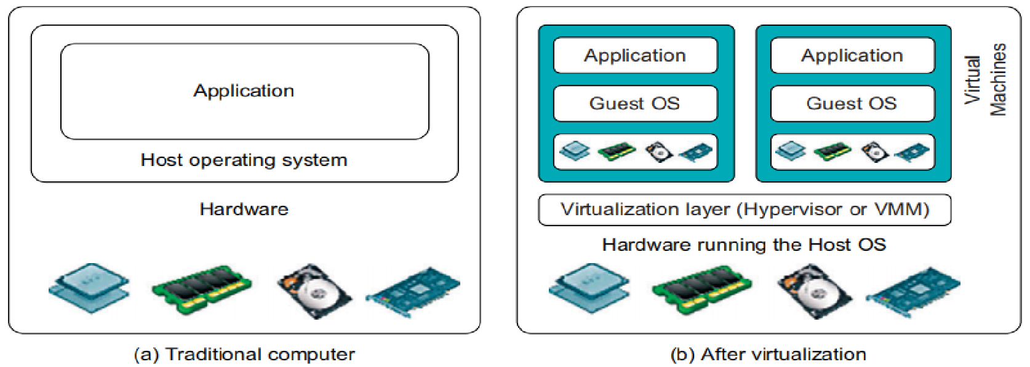
Implementation Levels of Virtualization
A traditional computer runs with a host OS specially tailored for its hardware architecture, as shown in Figure.
After virtualization, different user applications managed by their OS (guest OS) can run on same hardware, independent of host OS.
This is often done by adding additional software, called a virtualization layer.
This virtualization layer is known as hypervisor or virtual machine monitor (VMM).
In VMs applications run with their own guest OS over the virtualized CPU, memory, and I/O.

Slide 5
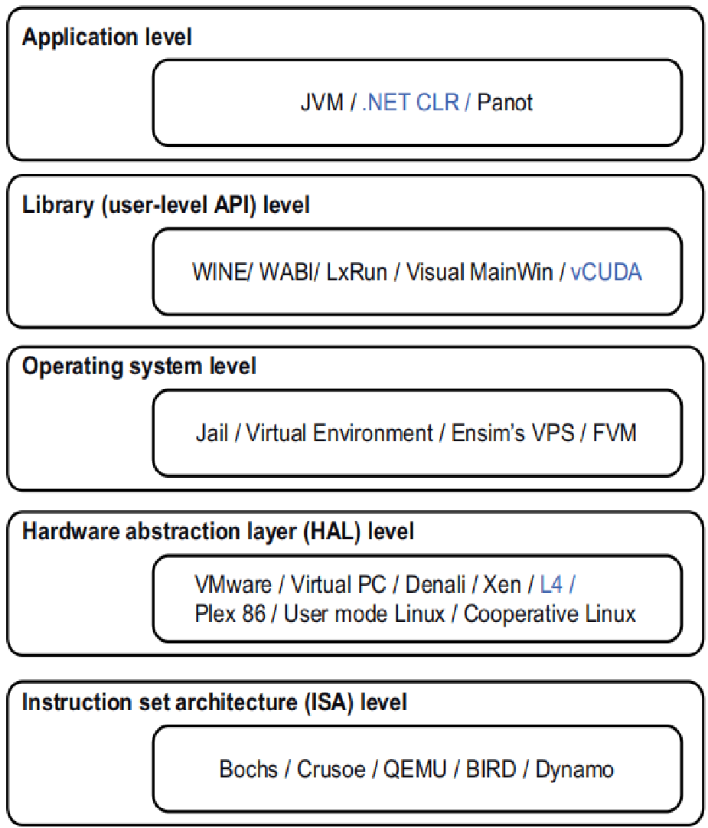
CCS
The main function of software layer for virtualization is to virtualize physical hardware of a host machine into virtual resources.
Virtualization software creates abstraction of VMs by interposing a virtualization layer at various levels of a computer system.
Common virtualization layers include:
instruction set architecture (ISA) level,
hardware level,
operating system level,
library support level, and
application level
Virtualization ranging from hardware to applications in 5 abstraction levels.

Slide 6
CCS- Instruction Set Architecture Level
Here virtualization is performed by emulating a given ISA by, the ISA of host machine.
Instruction set emulation leads to virtual ISAs created on any hardware machine.
Basic emulation method is through code interpretation.
An interpreter program interprets source instructions to target instructions one by one.
One source instruction may require 10s or 100s of native target instructions to perform its function.
For better performance, dynamic binary translation is desired.
This approach translates basic blocks of dynamic source instructions to target instructions.
The basic blocks can also be extended to program traces/super blocks to increase translation efficiency.
Instruction set emulation requires binary translation and optimization.
A virtual instruction set architecture (V-ISA) thus requires adding a processor-specific software translation layer to the compiler.

Slide 7
Hardware Abstraction Level
Hardware-level virtualization is performed on top of bare hardware.
It generates a virtual hardware environment for a VM.
On the other hand, the process manages the underlying hardware through virtualization.
The idea is to virtualize a computer’s resources, such as its processors, memory, and I/O devices.
The intention is to upgrade hardware utilization rate by multiple users concurrently.

Slide 8
Operating System Level
This refers to an abstraction layer between traditional OS and user applications.
OS-level virtualization creates isolated containers on a single physical server and the OS instances to utilize the hardware and software in data centers.
The containers behave like real servers.
OS-level virtualization is commonly used in creating virtual hosting environments to allocate hardware resources among a large number of mutually distrusting users.
It is also used, in consolidating server hardware by moving services on separate hosts into containers or VMs on one server

Slide 9
Library Support Level
Most applications use APIs exported by user-level libraries rather than using lengthy system calls by OS.
Virtualization with library interfaces is possible by controlling communication link between applications and rest of a system through API hooks.

Slide 10
User-Application Level
Virtualization at the application level virtualizes an application as a VM.
An application often runs as a process, Therefore, its also known as process-level virtualization.
The most popular approach is to deploy high level language (HLL) VMs.
Any program written in HLL and compiled for this VM will be able to run on it.
Other forms of application-level virtualization are known as application isolation, application sandboxing, or application streaming.
The process involves wrapping the application in a layer that is isolated from the host OS and other applications.
The result is, an application that is much easier to distribute and remove from user workstations.

Slide 11
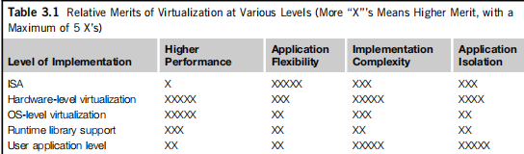
Relative Merits of Different Approaches
Table compares the relative merits of implementing virtualization at various levels.
The column headings correspond to 4 technical merits.
The number of X’s reflects the advantage points of each implementation level.
Overall, hardware and OS support will yield the highest performance.

Slide 12
VMM Design Requirements and Providers
Hardware-level virtualization inserts the Virtual Machine Monitor (VMM) layer.
There are 3 requirements for a VMM.
It should provide an environment that is identical to original machine.
Programs running here should show, at worst, only minor decreases in speed.
VMM should be in complete control of the system resources.
Program running under VMM should exhibit function identical to original machine.
2 possible exceptions are permitted with this requirement:
Differences caused by availability of system resources and
Differences caused by timing dependencies.
1st arises when more than one VM is running on same machine.

Slide 13
CCS
Complete control of these resources by a VMM includes the following aspects:
(1) The VMM is responsible for allocating hardware resources for programs;
(2) It is not possible for a program to access any resource not explicitly allocated to it;
(3) It is possible under certain circumstances for a VMM to regain control of resources already allocated.
Not all processors satisfy these requirements for a VMM.
If a processor is not designed to support virtualization, it is necessary to modify the hardware, to satisfy these 3 requirements.
This is known as hardware-assisted virtualization.

Slide 14
Virtualization Support at the OS Level
Why OS-Level Virtualization ?
It is slow to initialize a hardware-level VM because each VM creates its own image from scratch.
Storing the VM images also becomes an issue.
Full virtualization at the hardware level slows performance and lowers density.
OS-level virtualization provides a feasible solution for these hardware-level virtualization issues.
OS virtualization inserts a virtualization layer inside an OS to partition a machine’s physical resources.
It enables multiple isolated VMs within a single OS kernel.
This kind of VM is often called a virtual execution environment (VE), Virtual Private System (VPS), or simply container.

Slide 15
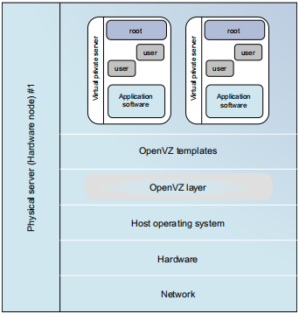
Virtualization Support at the OS Level
From user’s point of view: VEs look like real servers.
This means a VE has its own:
set of processes,
file system,
user accounts,
network interfaces with IP addresses,
routing tables,
firewall rules, and
other personal settings.
Although VEs can be customized, they share same OS kernel.
Therefore, OS-level virtualization is also called single-OS image virtualization.

Slide 16
Advantages of OS Extensions
Compared to hardware-level virtualization, the benefits of OS extensions are 2 fold:
(1) VMs at OS level have minimal startup/shutdown costs, low resource requirements, and high scalability; and
(2) It is possible for a VM and its host environment to synchronize state changes when necessary.
These benefits can be achieved via 2 mechanisms of OS-level virtualization:
(1) All OS-level VMs on the same physical machine share a single OS kernel; and
(2) The virtualization layer can be designed in a way that allows processes in VMs to access as many resources of the host machine as possible.

Slide 17
Disadvantages of OS Extensions
All VMs at OS level on a single container must have same kind of guest OS.
For example, a Windows distribution such as Windows XP cannot run on a Linux-based container.
However, Some users prefer Windows and others prefer Linux or other OS.
Therefore, there is a challenge for OS-level virtualization in such cases.

Slide 18
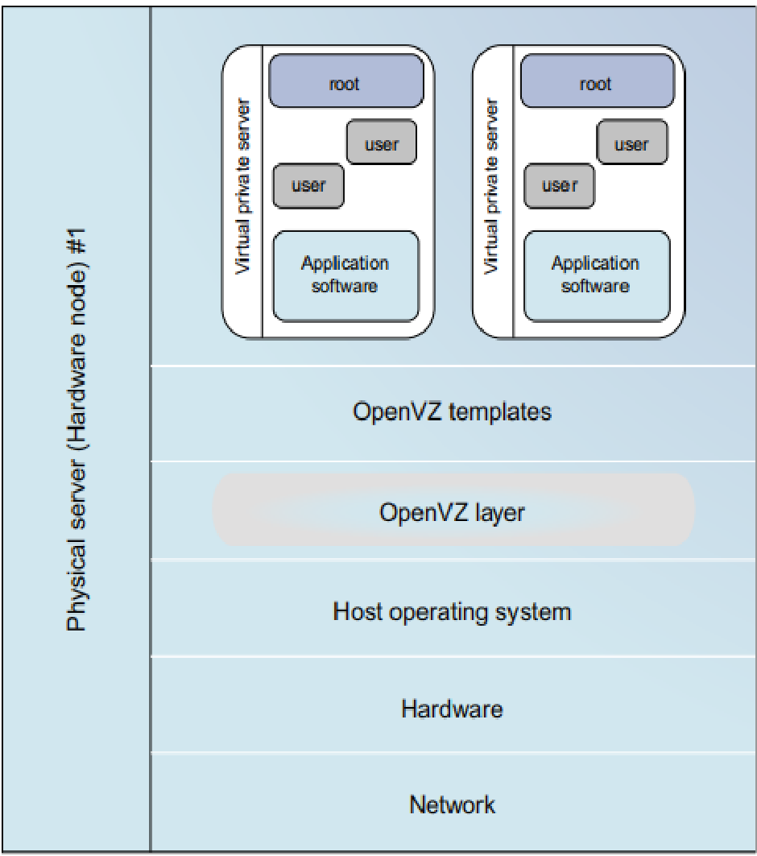
OS-level virtualization
Figure illustrates the concept of OS-level virtualization.
The virtualization layer is inserted inside OS to partition hardware resources for multiple VMs to run their applications in multiple virtual environments.
To implement OS-level virtualization, VMs should be created based on a single OS kernel.
The access requests from a VM need to be redirected to VM’s local resource partition on physical machine.
Virtual root directories are root directories of all VMs created
The OpenVZ virtualization layer inside the host OS, which provides some OS images to create VMs quickly.

Slide 19

OS-level virtualization
There are 2 ways to implement virtual root directories:
1. Duplicating common resources to each VM partition; or
2. Sharing most resources with host environment and only creating private resource copies on VM on demand.
The first way incurs significant resource costs and overhead on a physical machine.
This issue neutralizes benefits of OS-level virtualization.
Therefore, OS-level virtualization is often a second choice.

Slide 20
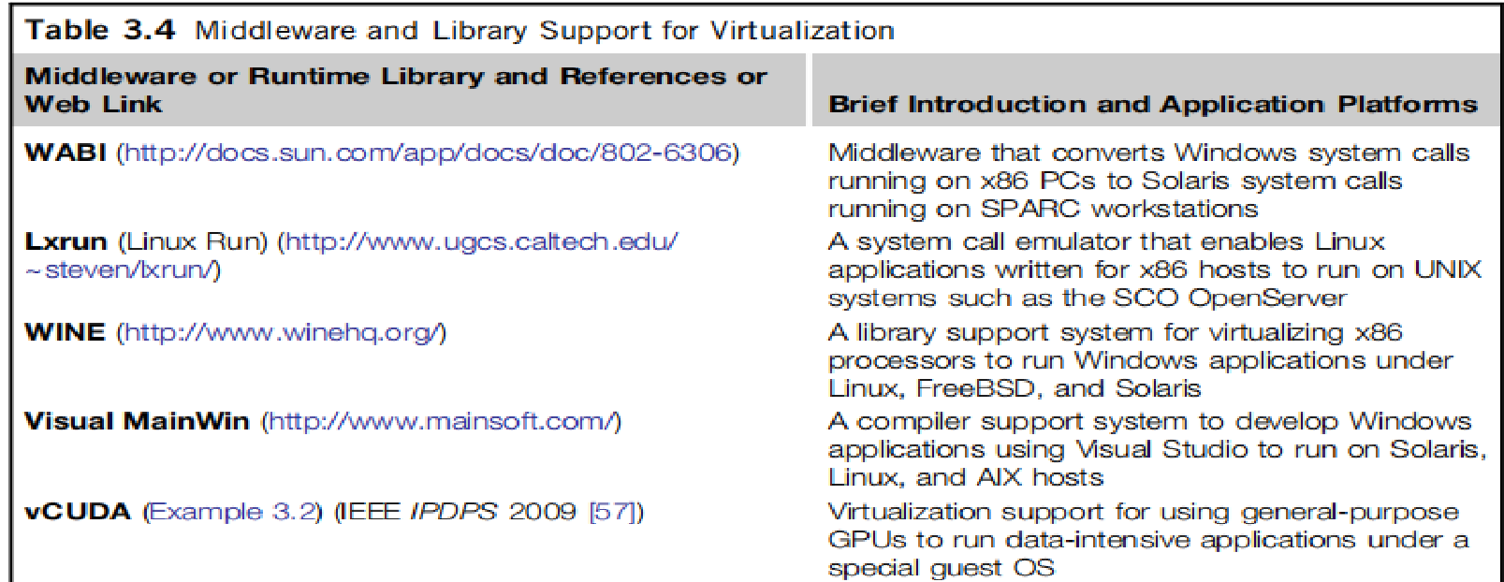
Middleware Support for Virtualization
Library-level virtualization is also known as user-level Application Binary Interface (ABI) or API emulation.
It can create execution environments for running alien programs rather than creating a VM to run entire OS.
API call interception and remapping are the key functions performed.

Slide 21
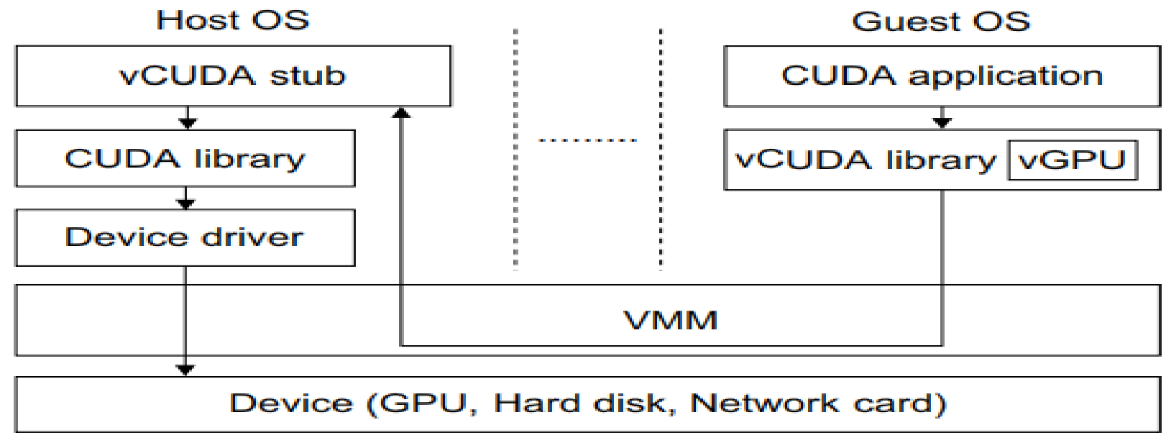
vCUDA for Virtualization of General-Purpose GPUs
CUDA is a programming model and library for general-purpose GPUs.
It is difficult to run CUDA applications on hardware-level VMs directly.
vCUDA virtualizes the CUDA library and can be installed on guest OSes.
When CUDA applications run on a guest OS and issue a call to the CUDA API, vCUDA intercepts the call and redirects it to the CUDA API running on the host OS.
Figure shows the basic concept of the vCUDA architecture.

Slide 22
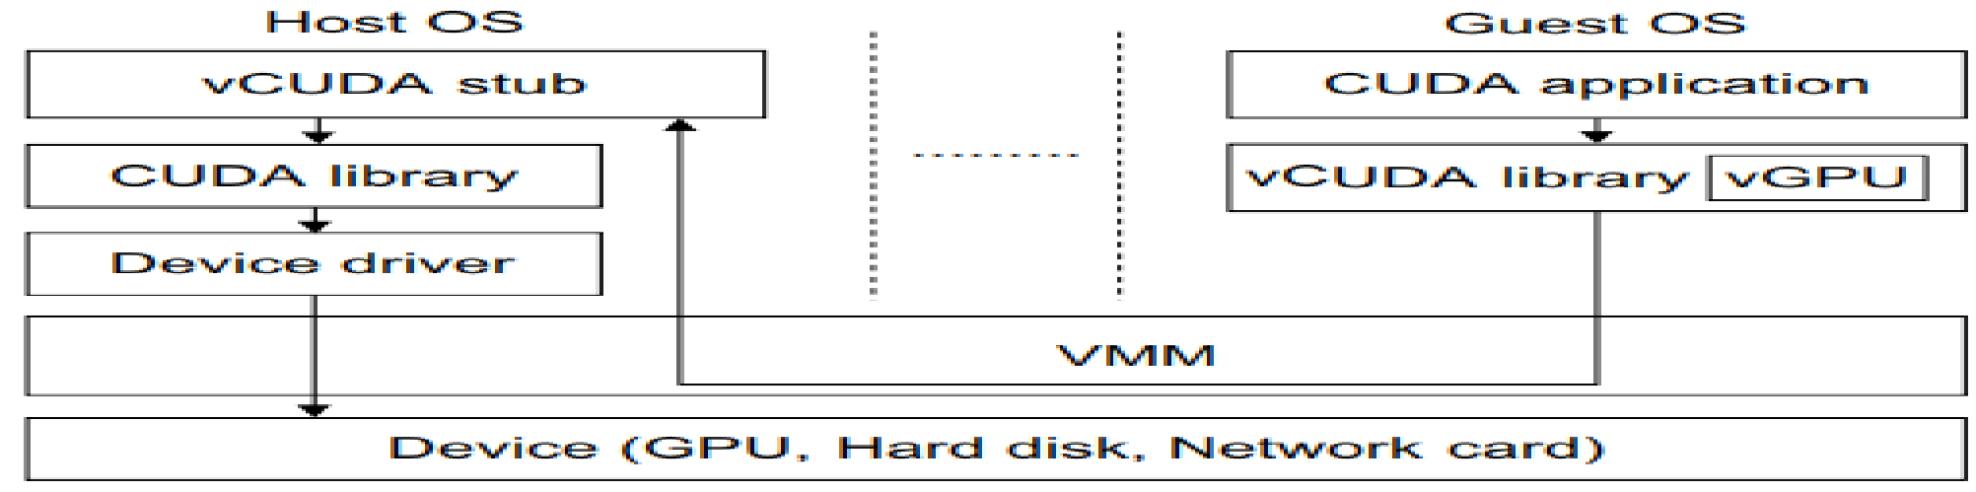
vCUDA for Virtualization of General-Purpose GPUs
vCUDA employs a client-server model to implement CUDA virtualization.
It consists of 3 user space components: vCUDA library, virtual GPU in guest OS (which acts as a client), and vCUDA stub in host OS (which acts as a server).
vCUDA is responsible for: intercepting and redirecting API calls from client to stub and also creates vGPUs and manages them.
vGPU abstracts GPU structure and gives applications a uniform view of underlying hardware.
It is responsible for storing CUDA API flow.
vCUDA stub receives and interprets remote requests and creates a execution context for API calls from guest OS, then returns the results to the guest OS.

Slide 23
VIRTUALIZATION STRUCTURES/TOOLS AND MECHANISMS
Depending on the position of the virtualization layer, there are several classes of VM architectures, namely:
The hypervisor architecture,
Paravirtualization, and
Host-based virtualization.
The hypervisor is also known as the VMM (Virtual Machine Monitor).
They both perform the same virtualization operations.

Slide 24
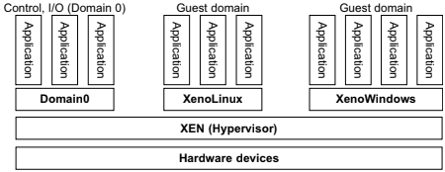
The Xen Architecture
Xen is a microkernel hypervisor, which separates the policy from mechanism.
Xen implements all mechanisms, leaving the policy to be handled by Domain 0
Xen provides a mechanism by which guest OS can directly access physical devices.
Xen provides a virtual environment located between hardware and OS.
Guest OS, with control ability, is Domain 0, & others are Domain U.
Domain 0 is first loaded when Xen boots without any file system drivers being available.
It is designed to access hardware directly and manage devices. Therefore, it allocates & map hardware resources for guest domains

Slide 25
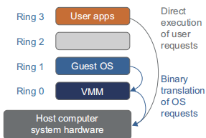
Binary Translation with Full Virtualization
Depending on implementation technologies, hardware virtualization can be classified into 2 categories: Full virtualization & Host-based virtualization.
Full virtualization :
Here noncritical instructions run on hardware directly while critical instructions are replaced with traps into VMM to be emulated.
Both the hypervisor and VMM approaches are considered full virtualization.
Binary Translation of Guest OS Requests Using a VMM:
VMware(company) put VMM at Ring 0 and guest OS at Ring 1.
VMM scans instruction stream and identifies privileged, control- and behavior-sensitive instructions.
Then they are trapped into VMM, which emulates the behavior of these instructions.
The method used in this emulation is called binary translation.
The guest OS is decoupled from hardware & it is unaware that it is being virtualized.

Slide 26
Binary Translation with Full Virtualization
Host-based virtualization :
Alternative VM architecture is: install a virtualization layer on top of host OS.
Host OS is responsible for managing hardware.
Guest OSes are installed and run on top of the virtualization layer.
Dedicated applications may run on the VMs.
Advantages of this architecture:
1st : User can install this VM architecture without modifying host OS.
The virtualizing software can rely on the host OS to provide device drivers and other low-level services.
2nd : It appeals to many host machine configurations.
Although it has flexibility, performance is too low to be useful.

Slide 27
Para-Virtualization with Compiler Support
Para-virtualization needs to modify the guest OS.
A para-virtualized VM provides special APIs requiring OS modifications in user applications.
The virtualization layer can be inserted at different positions in a machine software stack
It attempts to reduce virtualization overhead & improve performance.

Slide 28
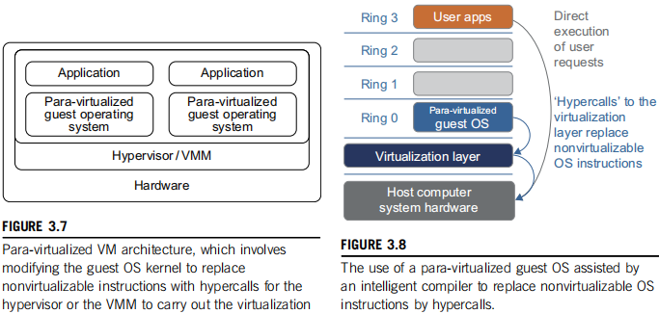
Para-Virtualization with Compiler Support
The guest OS are para-virtualized, as in figure.
They are assisted by compiler to replace nonvirtualizable OS instructions by hypercalls .
Traditional x86 processor offers 4 instruction execution rings: Rings 0, 1, 2, and 3.
Lower the ring number, higher the privilege of instruction being executed.
OS is responsible for managing hardware & privileged instructions to execute at Ring 0, while user-level applications run at Ring 3.
When guest OS kernel is modified for virtualization, it can no longer run on hardware directly.

Slide 29
VMware ESX Server for Para-Virtualization
VMware has developed virtualization tools for desktop systems & servers.
ESX is a VMM or hypervisor for bare-metal x86 symmetric multiprocessing (SMP) servers.
It accesses hardware resources directly & has complete resource management control.
An ESX-enabled server consists of 4 components:
a virtualization layer
a resource manager
hardware interface components, and
a service console
To improve performance, ESX server employs a para-virtualization architecture.
Here VM kernel interacts directly with hardware without involving host OS.

Slide 30
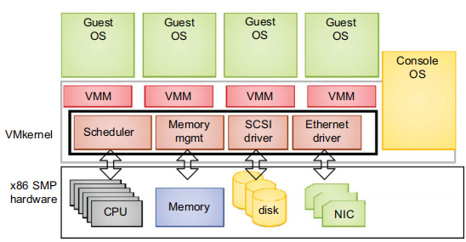
VMware ESX Server for Para-Virtualization
VMM layer virtualizes physical hardware resources.
Resource manager :
allocates CPU, memory disk, & network bandwidth &
maps them to virtual hardware resource set of each VM created.
Hardware interface components are: device drivers & VMware ESX Server File System.
The service console is responsible for:
booting the system,
initiating the execution of VMM & resource manager, &
relinquishing control to those layers.
It also facilitates the process for system administrators.

Slide 31
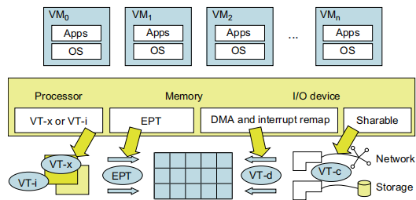
VIRTUALIZATION OF CPU, MEMORY, AND I/O DEVICES
Hardware Support for Virtualization in the Intel x86 Processor
Since software-based virtualization techniques are complicated & incur performance overhead, Intel provides a hardware-assist technique.
VT-x or VT-i technique is used for Process virtualization. VT-x adds a privileged mode & instructions to processors.
Intel offers EPT for memory virtualization. It translates virtual address to machine’s physical addresses to improve performance.
For I/O virtualization, Intel implements VT-d and VT-c to support this.
Overview of Intel’s full virtualization techniques

Slide 32
CPU Virtualization
A CPU architecture is virtualizable if it supports the ability:
To run VM’s privileged and unprivileged instructions in the CPU’s user mode &
To run VMM in supervisor mode.
Hardware-Assisted CPU Virtualization attempts to simplify virtualization because full or paravirtualization is complicated.
Intel added an additional mode: privilege mode level to x86 processors.
OS can still run at Ring 0 & hypervisor can run at Ring 1.
All privileged and sensitive instructions are trapped in hypervisor automatically.
This technique lets OS run in VMs without modification.

Slide 33
CPU Virtualization
Intel’s VT-x technology is an example of hardware-assisted virtualization.
To control start & stop & maintain CPU state for VMs, set of additional instructions are added.
Generally, hardware-assisted virtualization should have high efficiency.
Virtualization systems like VMware use a hybrid approach, in which few tasks are offloaded to hardware but rest is still done in software.

Slide 34
Memory Virtualization
Modern x86 CPUs include memory management unit (MMU) & translation lookaside buffer (TLB) to optimize virtual memory performance.
Virtual memory virtualization involves sharing physical system memory in RAM & dynamically allocating it to physical memory of VMs.
2-stage mapping process should be maintained by guest OS & VMM:
virtual memory to physical memory and
physical memory to machine memory.
VMM is responsible for mapping guest physical memory to actual machine memory.

Slide 35
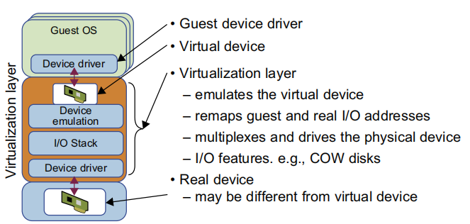
I/O Virtualization
It involves managing: routing of I/O requests between virtual devices & shared physical hardware.
There are 3 ways to implement I/O virtualization:
full device emulation,
para-virtualization, and
direct I/O.
Full device emulation: It emulates well-known, real-world devices.
All functions of a device or bus infrastructure are replicated in software.
I/O access requests of guest OS are trapped in VMM which interacts with I/O devices

Slide 36
Physical versus Virtual Processor Cores
Multicore virtualization method increases the burden & inefficiency of managing hardware resources by software.
Physical Core is located under ISA & remains unmodified by OS or VMM.
Figure illustrates;
Technique of a software-visible VCPU moving from one core to another and
It is Temporarily suspending execution of a VCPU when there are no appropriate cores on which it can run.

Slide 37
Virtual Hierarchy
A virtual hierarchy is a cache hierarchy that can adapt to fit workload or mix of workloads.
The hierarchy’s 1st level :
locates data blocks close to the cores for faster access,
establishes a shared-cache domain, and
establishes a point of coherence for faster communication.
When a miss leaves a tile, it first attempts to locate the block within 1st level.
The 1st level can also provide isolation between independent workloads. A miss at the L1 cache can invoke the L2 access.
The idea is illustrated in Figure

Slide 38
CCS
Figure illustrates 2 level logical view of virtual cluster hierarchy.
Each VM operates in a isolated fashion at the 1st level.
This minimize both miss access time and performance interference with other workloads or VMs.
The 2nd level maintains a globally shared memory.
Facilitates dynamically repartitioning resources.
Minimizes changes to existing system software and allows virtualization features.

Slide 39
VIRTUAL CLUSTERS AND RESOURCE MANAGEMENT
Each virtual cluster is formed with physical machines(PM) or VM hosted by multiple physical clusters.
Provisioning of VMs to virtual cluster is done to have following properties:
The virtual cluster nodes can be either PM or VM. Multiple VMs running with different OSes can be deployed on same physical node.
VM runs with guest OS, that manages resources in PM, where VM is implemented.
Purpose of using VMs is to consolidate multiple functionalities on same server. To enhance server utilization & application flexibility
Fig: A cloud platform with four virtual clusters over three physical clusters shaded differently.

Slide 40
VIRTUAL CLUSTERS
VMs can be replicated in multiple servers for the purpose of promoting distributed parallelism, fault tolerance, and disaster recovery.
The size of a virtual cluster can grow or shrink dynamically, similar to the way an overlay network varies in size in a peer-to-peer (P2P) network.
The failure of any physical nodes may disable some VMs installed on the failing nodes. But the failure of VMs will not pull down the host system.
In a virtual cluster system, it is quite important to store the large number of VM images efficiently.
Figure shows the concept of a virtual cluster based on application partitioning or customization

Slide 41
THANK YOU

